Slide 1




Performance Trends, Comparisons, and Investment Insights
Slide
1
BITCOIN VS S&P 500: COMPREHENSIVE MARKET ANALYSIS
Next
https://github.com/Sabdikay

Slide 2


Slide
2
AGENDA
This presentation covers:
1. Overview of Data
2. Bitcoin Closing Prices Trend
3. Monthly Average Close Price Comparison
4. Daily High Price Trends
5. Price Spread Analysis
6. Upside Potential Comparison
7. Key Insights
8. Final Recommendation
https://github.com/Sabdikay
Next

Slide 3

Slide
3
OVERVIEW OF DATA
Data Sources: Bitcoin and S&P 500 daily price records.
Time Period: Selected dates in 2021.
Metrics Analyzed: Opening, Closing, High, Low prices, and Volume.
Focus: Performance comparison between Bitcoin and S&P 500.
https://github.com/Sabdikay
Next

Slide 4
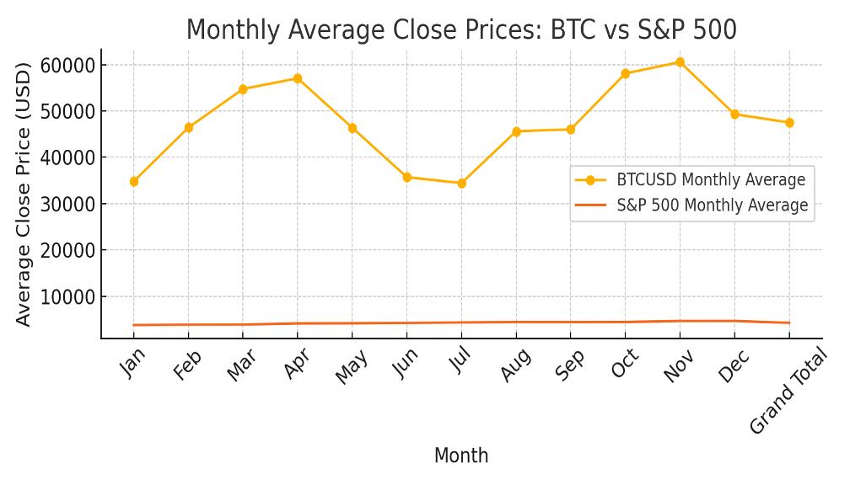
MONTHLY AVERAGE CLOSE PRICES: BTC VS S&P 500
Slide
4
-BITCOIN SHOWED LARGER MONTHLY PRICE FLUCTUATIONS COMPARED TO S&P 500.
-S&P 500 presented consistent, stable growth.
-Bitcoin's volatility implies higher risk but also higher reward potential.
https://github.com/Sabdikay
Next

Slide 5
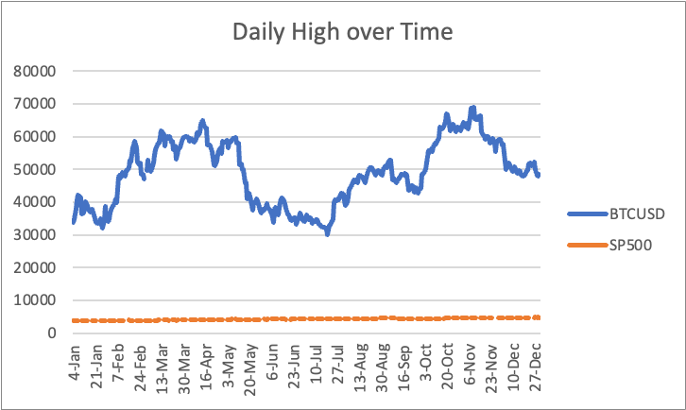
DAILY HIGH PRICES: BTC VS S&P 500
Slide
5
-BITCOIN DISPLAYED MORE EXTREME HIGHS COMPARED TO S&P 500.
-S&P 500 exhibited stable growth with less volatility.
-Highlights Bitcoin's speculative peaks and trading opportunities.
https://github.com/Sabdikay
Next

Slide 6
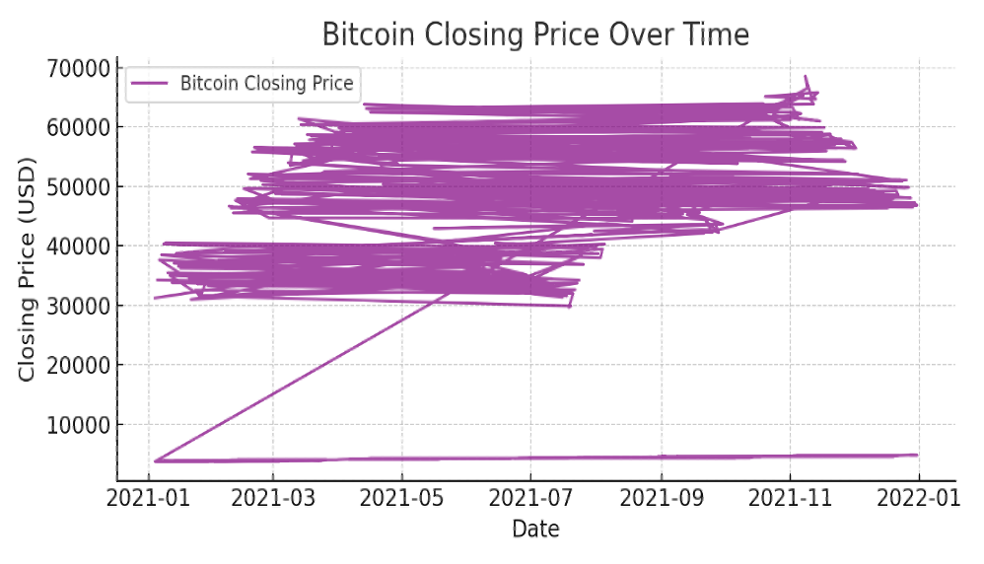
BITCOIN CLOSING PRICE TREND
Slide
6
-Bitcoin's closing prices exhibited high volatility.
-Significant peaks and corrections observed.
-Demonstrates Bitcoin's speculative nature.
https://github.com/Sabdikay
Next

Slide 7
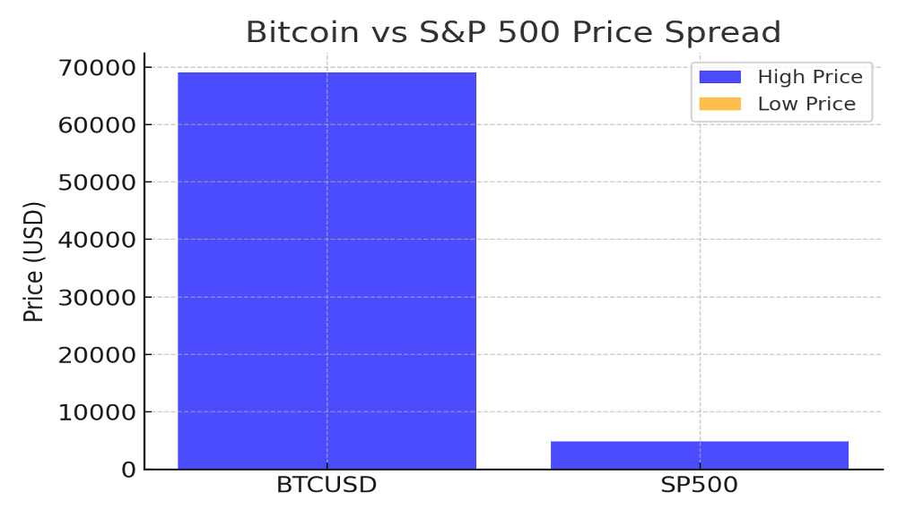
PRICE SPREAD COMPARISON: BTC VS S&P 500
Slide
7
-Bitcoin's price spread (high-low) was significantly larger than S&P 500.
-Reflects Bitcoin's higher volatility and risk.
-Indicates opportunities for swing trading and short-term gains.
https://github.com/Sabdikay
Next

Slide 8

KEY INSIGHTS
Slide
8
-Bitcoin offers high reward but comes with high volatility.
-S&P 500 is stable and ideal for low-risk portfolios.
-Monthly averages show Bitcoin's volatile nature compared to the steady S&P 500.
-Daily highs highlight Bitcoin's speculative peaks.
-Upside analysis favors Bitcoin for aggressive investment strategies.
https://github.com/Sabdikay
Next

Slide 9

Slide
9
t
THANK YOU!
For more information, contact us at
https://github.com/Sabdikay
Back

